Slide 1
Rock Buster
Jr Data Analysist Ethan Hennes

Slide 2
Objectives
Explore and profile Rock Busters most vital information
Find what countries contain the highest concentrations of customers.
Find in those top countries the most active members so we can thank them and give back for their patronage.

Slide 3
Descriptive Stats
MIN
MIN
MIN
.99
3 Days
9.99
.99
MAX
MAX
MAX
4.99
7 Days
29.99
AVERAGE
AVERAGE
AVERAGE
2.98
5 Days
19.98
Rental
Rates
Rental
Duration
Rental Replacement Cost

Slide 4
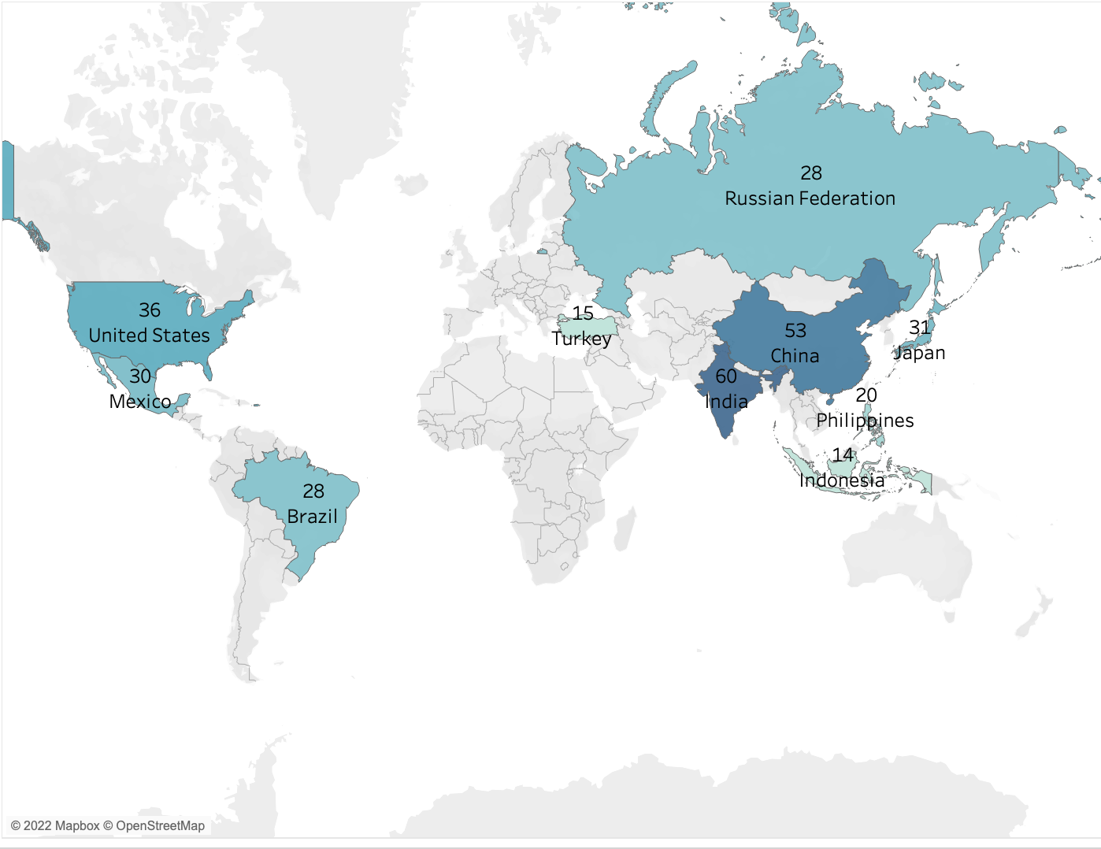
Top Ten countries by amount of customers
India | 60
China | 53
United States | 36
Japan | 31
Mexico | 30
Brazil | 28
Russian Federation | 28
Philippines | 20
Turkey | 15
Indonesia | 14

Slide 5
India’s top 3 highest earning Genres, Actors, and film lengths
GENRES ACTORS FILM LENGTHS
Sports
Foreign
Documentary
Children
Drama
Gina | Degeneres
Cameron | Zellweger
Albert | Johansson
Susan | Davis
Christian | Akroyd
85 minutes
178 minutes
121 minutes
100 minutes
112 minutes

Slide 6
China’s top 3 highest earning Genres, Actors, and film lengths
GENRES ACTORS FILM LENGTHS
Animation
Sports
Family
New
Drama
Susan | Davis
Jayne | Nolte
Matthew | Carrey
Kirsten | Akroyd
Walter | Torn
179 minutes
75 minutes
85 minutes
102 minutes
109 minutes

Slide 7
United states top 3 highest earning Genres, Actors, and film lengths
GENRES ACTORS FILM LENGTHS
Sports
Drama
Documentary
Comedy
Animation
Walter | Torn
Jayne | Nolte
Christian | Akroyd
Rip | Crawford
Susan | Davis
167 minutes
121 minutes
84 minutes
110 minutes
85 minutes

Slide 8
Japan’s top 3 highest earning Genres, Actors, and film lengths
GENRES ACTORS FILM LENGTHS
New
Drama
Animation
Sci-Fi
Sports
Scarlett | Damon
Gregory | Gooding
Henry | Berry
Val | Bolger
Kenneth | Torn
112 minutes
75 minutes
74 minutes
114 minutes
138 minutes

Slide 9
Mexico's top 3 highest earning Genres, Actors, and film lengths
GENRES ACTORS FILM LENGTHS
Sports
Sci-Fi
Foreign
Drama
Action
Ed | Mansfield
Cameron | Zellweger
Kenneth | Torn
Lucille | Dee
John | Suvari
74 minutes
178 minutes
150 minutes
73 minutes
92 minutes

Slide 10
Brazil's top 3 highest earning Genres, Actors, and film lengths
GENRES ACTORS FILM LENGTHS
Sports
Animation
Sci-Fi
New
Horror
Gina | Degeneres
Susan | Davis
Michael | Bolger
Warren | Nolte
Will | Wilson
112 minutes
85 minutes
118 minutes
92 minutes
100 minutes

Slide 11
Russian federation’s top 3 highest earning Genres, Actors, and film lengths
GENRES ACTORS FILM LENGTHS
Sci-Fi
Family
Action
Classics
Games
Susan | Davis
Helen | Voight
Bela | Walken
Gina | Degeneres
Matthew | Carrey
112 minutes
178 minutes
65 minutes
148 minutes
85 minutes

Slide 12
Philippine’s top 3 highest earning Genres, Actors, and film lengths
GENRES ACTORS FILM LENGTHS
Animation
Foreign
Sports
Games
Comedy
Val | Bolger
Walter | Torn
Rip | Crawford
Reese | West
Susan | Davis
112 minutes
59 minutes
85 minutes
80 minutes
148 minutes

Slide 13
Turkey's top 3 highest earning Genres, Actors, and film lengths
GENRES ACTORS FILM LENGTHS
Drama
Animation
Children
Foreign
Comedy
Susan | Davis
Sandra | Kilmer
Vivien | Bergen
Kevin | Garland
Johnny | Lollobrigida
48 minutes
110 minutes
112 minutes
84 minutes
147 minutes

Slide 14
Indonesia’s top 3 highest earning Genres, Actors, and film lengths
GENRES ACTORS FILM LENGTHS
Action
Drama
New
Music
Foreign
Anne | Cronyn
Susan | Davis
Kirsten | Akroyd
Tom | Miranda
Matthew | Carrey
121 minutes
64 minutes
80 minutes
149 minutes
75 minutes

Slide 15
We want to reward the top rock buster customers
We took the top ten countries and found the top 5 customers of all ten countries.
We then found their top two favorite film genres so we could send them a movie double feature of their two favorite genres.
Scott | Shelley | Aurora | United States
Bob | Pfeiffer | Xintai | China
Bernard | Colby | Dhule (Dhulia) | India
Erica | Matthews | Pingxiang | China
Rebecca | Scott | Kurashiki | Japan
Rebecca | Scott | Horror
 |  | Games
Erica | Matthews | Foreign
 |  | Sports
Scott | Shelley | Sports
 |  | Children
Bernard | Colby | Drama
 |  | Foreign
Bob | Pfeiffer | Children
 |  | Horror

Slide 16
Moving Forward
Focus on tailoring advertisement to each specific country in the top ten countries
Highlight movies that contain elements from each countries' top genres, run times, and top actors.
To show our appreciation to our most active customers we cold send them a movie night double feature with films of their favorite genres.

